Slide 1
PROFESSIONAL DEVELOPMENT

Slide 2
DISCUSSION/LEARNING TOPICS
Online Service Record
Evaluation Continuity
Career Development Boards
Career Management System

Slide 3
OMPF RECORD REVIEW https://www.bol.navy.mil
Your OMPF is your entire career and should be treated as your whole world!!

Slide 9
How to remove duplicates from your OMPF:
cscmailbox@navy.mil
This organizational e-mail accepts encrypted e-mails, please include your full SSN. This helps speed up the purging of your record.
DO NOT SUBMIT DOCUMENTS TO THIS E-MAIL ADDRESS. It will be deleted with no response.
See the following slide for e-mail template.

Slide 11
What if I need items added to my OMPF?
Legible copies of missing awards, evals, NAVPERS 1070/604, 605, 613, and enlistment documents can be mailed to (please keep in mind that this can take up to 3 months, so be proactive!):
Commander
Navy Personnel Command (PERS 312)
5720 Integrity Drive
Millington TN 38055

Slide 12
Performance Summary Record https://www.bol.navy.mil
Your career in a snap shot, the down and dirty

Slide 14
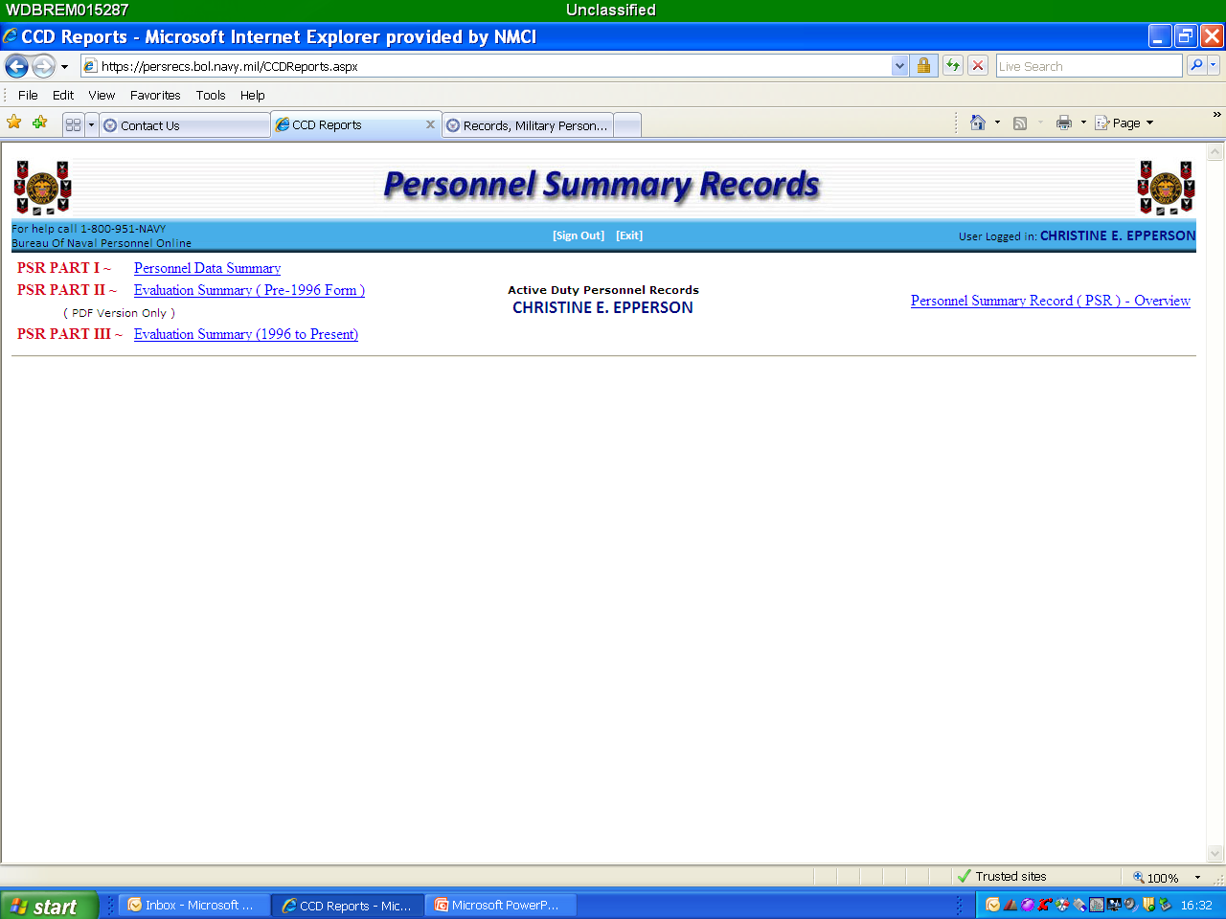

Slide 16
What if an award is missing out of my PSR?
The PSR lists the Life Saving Medals, Achievement Medals, and personal awards of higher precedence with the exception of the Purple Heart. All personal awards must be sent by the NOSC to the NADWS authority (RCC NW) to be reflected in the system. NOTE: Good Conduct Medals and campaign, service or unit awards are not listed on the PSR (AKA - NAM or higher).
If you run an NDAWS search for a personal award and find it in NDAWS but do not see the award in your PSR via BOL, you must mail a legible, clean copy of the signed citation, with your SSN printed in the upper right hand corner and write “IN NDAWS NOT ON PSR”, to PERS 312.

Slide 18
What if I am missing evals off of my PSR?
Evals on your PSR only reflect evals received as E5 and above. There should be no E4 and below evals reflecting in your eval summary.
If you are missing an E5 or above eval, mail the missing eval to PERS 32 to be updated.

Slide 19
Condensed version

Slide 20
NDAWS https://awards.navy.mil
Personal Awards -- This also updates your awards in NSIPS (NAMs and higher)

Slide 24
How do I update my NDAWS?
Bring a legible copy of your award certificate (and 1650 if you have it) to NOSC Admin. We will submit this to RCC NW to be updated. These updates are pretty quick (no longer than 4 weeks). Awards entered into NDAWS feed into your PSR and NSIPS ESR (this process takes a little longer depending on the data feed schedule).

Slide 25
NSIPS ESR https://nsips.nmci.navy.mil
The replacement for your Field Service Record (AKA - paper service record)

Slide 35
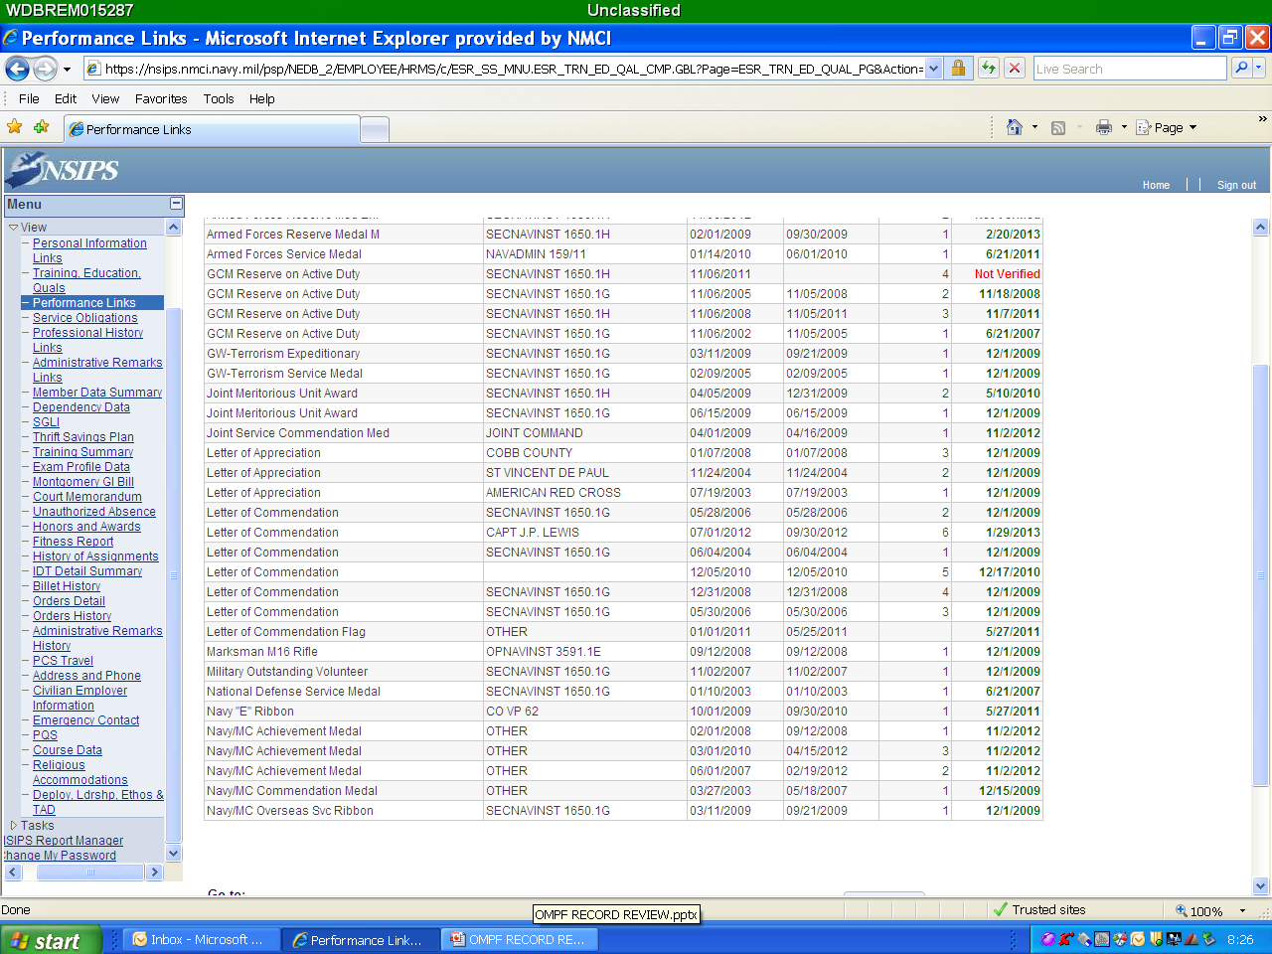

Slide 36
How do I get courses and/or awards entered into my NSIPS ESR?
Awards: Anything NAM or higher
Bring your award certificate or page 13 to NOSC Admin and we can enter it. Anything NAM or higher
Courses:
Bring your certificate of completion or page 13 to NOSC Admin and we can enter it.

Slide 38
What if I am missing evals in my NSIPS ESR?
Mail your eval to PERS 32. Evals that have been accepted by PERS 32 are entered into the NSIPS ESR by PERS 32. This can take some time, so please be proactive!

Slide 39
Be proactive about your career and review these records at least once a year! Any questions?

Slide 40
Career Development
Command Career Counselor

Slide 41
Learning Objectives
Career Development Boards
Career Management System

Slide 42
Career Development Board
The command master chief, senior enlisted leader and the command career counselor team are critical focal points for career development initiatives within the command.

Slide 43
Career Development Board
Maintain personnel stability by retaining top quality Sailors in the proper skills balance and in the required numbers;
Ensure all Sailors and their families are provided the necessary guidance to make informed career decisions
Encourage members to actively participate in the Navy Reserve if they leave Active duty and ensure they receive appropriate transition counseling

Slide 44
Career Development Board
CDBs are required for all Sailors upon reporting to a command, after six months on board, at 12-months on board and at 12-month intervals thereafter. Official guidance is contained in OPNAVINST 1040.11D, Navy Enlisted Retention and Career Development Program.
Also when a Sailor fails to advance off an advancement exam or board. – These are often the most important for getting a Sailor back on the right track.

Slide 45
Career Development Board
Typical topics covered during a CDB include watch-standing qualifications, continued education goals, advancement, short- and long-term career objectives, Perform-to-Serve (PTS) and Armed Services Vocational Aptitude Battery (ASVAB) scores. Leadership can use CDBs to learn the priorities of the Sailor and align the Sailor’s priorities to the needs of the Navy.
Following the CBD, the detailed minutes and recommendations are captured in the Career Information Management System (CIMS) by the career counselor or member of the chain of command authorized by the command for documentation. This includes what was discussed and is used to help keep the current and future commands informed of the Sailor’s progress and career goals.
With full access to the Electronic Service Record (ESR) for each Sailor, the career counselor is able to gain a thorough understanding of the Sailors’ experience and performance, resulting in recommendations best tailored to the Sailor and to more precisely tailor a career development path.

Slide 46
CIMS – Career Information Management System
Reports are easily compiled allow for command tracking of CDBs, Family Care Plan, PTS, Projected Rotation Date (PRD), and End of Active Obligated Service (EAOS).
CIMS is available to all shore commands with Internet access and on board 150 ships using CIMS Afloat on the Navy Standard Integrated Personnel (NSIPS) server. As the Navy’s primary business solution for human resources management, NSIPS is the system and data platform on which CIMS operates. The primary function of CIMS is to assist career counselors and those responsible with tracking, conducting and documenting CDBs.

Slide 47
CMS/ID
Reserve Component (RC) sailors should start applying right at their 9 month window.
RC Sailors will become In Assignment Processing (IAP) once their PRD expires and they will be subject to the needs of the Navy.

Slide 48
CMS/ID
CMS-ID is designed and used by Sailors, Command Career Counselors and Command Personnel. The Web-based system allows Sailors to view available jobs and make their own applications or through their Command Career Counselor. Sailors can view CMS-ID through a secure website located at
HTTPS://WWW.CMSID.NAVY.MIL

Slide 49
CMS/ID
CCC – Man-power can assist also
Chiefs should be able to step a Sailor through this process as well as they can through NROWS.
CCCs maintain the ability to submit job applications for Sailors.
Interaction between Command - CCC - Detailer - Sailor remains the most important aspect of career management.
Sailors will continue to work with their CCCs and/or Detailers for their next job assignments.
Sailors will continue to rely on robust command involvement to ensure none enter the detailing process without guidance and mentorship.
Deckplate leaders will continue to encourage Sailors to seek informed counsel and work closely with their CCCs throughout the orders negotiation process.
Sailors must be within their orders negotiation window to submit job applications. CMS/ID will block any application attempts outside the negotiation window.
Command leadership will ensure Sailors are provided access to CAC-enable computers and to the Internet to support detailing efforts.

Slide 50
Questions?

Slide 51
ONLINE SEVICE RECORDS
Where are they located?
What do they contain?
Can you correct them?
How do you correct them?
Why are they important?
Notes:
All active duty and reserve personnel having a BOL account, a Common Access Card (CAC) and a CAC-enabled computer can now view their OMPF record online by selecting the "OMPF - My Record" link under the BOL Application Menu. See NAVADMIN 011/09 for details.
OMPF - My Record provides a secure and efficient method for you to access and review your image record 24/7 and is the preferred method of obtaining OMPF information and correcting your records (see Corrections below) vice ordering the OMPF on CDROM (eliminates unnecessary delays caused by waiting days/weeks to received a CD).
Ordering a CD should only be done for retaining your complete OMPF record on CD for emergency situations (i.e. backup file; document loss due to system-file corruption). The CD should be kept in a safe and secured place. Remember once document(s) are scanned to the OMPF record here at NPC they are destroyed - See Records Management and Policy.
Your OMPF reflects documents that have been received, reviewed, and accepted as an official document. Documents that have been sent to Navy Personnel Command (NPC) within the past few months may still be in process of being scanned to the OMPF record. Do not resend these documents.
With "OMPF - My Record" you are able to view, download and print the documents as you would with the documents on the CDROM.
___________________________________________________________________________________________________________________________________________________________
Corrections
Evaluations/Fitness Reports - For all Evaluations or Fitness Reports issues (this includes removal of duplicates/someone else’s report(s)), please contact PERS-32.
Personal Data Record – Your Personal Data Record (corporate data) to name a few such as ESR, PSR, ODC, ETJ, NDAWS is updated by various other agencies such as your servicing PSD, Personnel Office or NSIPS.
Please contact your Personnel Office or NSIPS for assistance in correcting or who to contact for correcting corporate data.
PERS-313 does not correct Data Records.
OMPF Image Documents - To correct documents in your OMPF record see our webpage’s Document Correction, Document Submission, Frequently Asked Questions (FAQ) and Contact Us.
Before submitting corrections to us please review the webpage’s above, our “Contact Us” page has an email address that you can submit corrections to.
Note: Correcting your image record (OMPF) does not correct your Personal Data Record (see Personal Data Record above).
An official document submitted to NAVPERSCOM for filing in the Official Military Personnel File (OMPF) becomes the property of Department of Navy (DON). Except for administrative or clerical errors, documents filed in the OMPF may not be removed or changed except by authorization of Secretary of Navy.
(1) If you find an error in your OMPF, you may request a correction to your service record. You should submit your request to your local Personnel Support Detachment (PSD) or Personnel Office (PersO) for action since the error may be found in your OMPF, the Field Service Record, and in some cases other corporate databases. Request must include a description of the information to be changed; the reason for the change; the type of change sought (i.e., deletion, correction, or addition); and copies of available documentary evidence supporting the request. The PSD/PersO may make corrections to local records and/or submit changes to NAVPERSCOM in accordance with MILPERSMAN 1070-210, or in accordance with the regulation governing original document. In general, the following types of corrections may be made, where appropriate:
Remove a document that was erroneously filed in your record, i.e., another member’s document filed in your record, or a document was filed in your record contrary to policy or regulation. If this document is in your OMPF, you may request this type of correction directly from NAVPERSCOM (PERS-313). Please read the FAQ section and the 'Contact Us' page before submitting requests.
Remove a document found in your record that is not legible, and replace it with a clean readable copy of the document (submit the new document under a cover letter, to NAVPERSCOM (PERS-313)).
Correct an error on a document, when the correction is mandated by regulation (e.g. the regulation requires a specific word or code, such as a reenlistment code, but the clerk entered an erroneous code).
Correct an error on a document if it is readily apparent on the face of the document that a clerical error was made (e.g., evident a service member reenlisted for 6 years, but dates provided indicate only a 5 year reenlistment; reenlisted on 24 DEC 04 for 6 years (24 DEC 10) but contract indicates enlistment expires 24 DEC 09). This is restricted to changes that “do not” create a retroactive pay entitlement (see subparagraph (5) below).
(2) A document may be amended or supplemented by correspondence forwarded via official channels.
(3) If the change requested is a material change or if change requested is not covered by the above paragraphs, the matter must be referred to the Board for Correction of Naval Records (BCNR) in accordance with MILPERSMAN 1000-150.
(4) If the matter in question involves a matter of opinion, judgment or the exercise of discretion, such as a performance evaluation, refer it to BCNR.
(5) The Comptroller General (CompGen) has consistently held that except for corrections made by BCNR, there is no authority to retroactively correct a military record in order to create a pay entitlement for a prior period. If the change requested will create a retroactive claim for pay and/or allowances, refer it to BCNR. Even if the error is an obvious clerical error, if money or entitlement is involved, refer it to BCNR.
The following MILPERSMANs provides guidance on correcting the Naval Record (see References for direct links):
MILPERSMAN 1070-020 Officer Permanent Personnel Record MILPERSMAN 1070-080 Enlisted Permanent Personnel Record MILPERSMAN 1070-210 Correction of the Field Service Record

Slide 52
EVALUATION CONTINUITY
What is Evaluation Continuity?
What can you do to fix an evaluation?
Who is this important to?
Why is this important even as a Chief/Senior Chief and Master Chief?
Notes:
Not having a gap between the end date of an evaluation and the reporting date of the next evaluation. Members can receive Non Observed(NOB) evaluations if at the command 90 days or less. A regular eval may go 15 months if a member makes rank and would change his evaluation periodicity. However, members cannot miss a period eval for their paygrade. Frocking evaluations are not required if the member will get an evaluation within 15 months of the end date of their last evaluation.
The Individual Continuity Report can also be accessed on BOL by all Navy personnel in pay grades E-5 and above. Just click on the Fitrep/Eval Reports icon.
A letter of correction must be submitted and signed by the Reporting Officer that signed the initial evaluation.
This is important to ALL of our Sailors. Junior people to the most senior. Not having continuity for 90 days is a “indicator” which causes records to be any of the Preceps areas of consideration would cause a record to come under scrutiny.

Slide 53
CAREER DEVELOPMENT BOARDS
Who is in charge of Career Development Boards (CDBs)?
When are they required? What is discussed?
Can they be done when not required?
Why do we care about CDBs?
Notes:
The command master chief, chief of the boat, senior enlisted leader and the command career counselor team are critical focal points for career development initiatives within the command. Reports easily compiled allow for command tracking of CDBs, Family Care Plan, PTS, Projected Rotation Date (PRD), and End of Active Obligated Service (EAOS).
--------------------------------------------------------------------------------------------------------------------------
CDBs are required for all Sailors upon reporting to a command, after six months on board, at 12-months on board and at 12-month intervals thereafter. Official guidance is contained in OPNAVINST 1040.11D, Navy Enlisted Retention and Career Development Program.
Also when a Sailor fails to advance off an advancement exam or board. – These are often the most important for getting a Sailor back on the right track.
Typical topics covered during a CDB include watch-standing qualifications, continued education goals, advancement, short- and long-term career objectives, Perform-to-Serve (PTS) and Armed Services Vocational Aptitude Battery (ASVAB) scores. Leadership can use CDBs to learn the priorities of the Sailor and align the Sailor’s priorities to the needs of the Navy.
Following the CBD, the detailed minutes and recommendations are captured in CIMS by the career counselor or member of the chain of command authorized by the command for documentation. This includes what was discussed and is used to help keep the current and future commands informed of the Sailor’s progress and career goals.
With full access to the Electronic Service Record (ESR) for each Sailor, the career counselor is able to gain a thorough understanding of the Sailors’ experience and performance, resulting in recommendations best tailored to the Sailor and to more precisely tailor a career development path.
CIMS is available to all shore commands with Internet access and on board 150 ships using CIMS Afloat on the Navy Standard Integrated Personnel (NSIPS) server. As the Navy’s primary business solution for human resources management, NSIPS is the system and data platform on which CIMS operates. The primary function of CIMS is to assist career counselors and those responsible with tracking, conducting and documenting CDBs.
-----------------------------------------------------------------------------------------------------------------
a. Maintain personnel stability by retaining top quality Sailors in the proper skills balance and in the required numbers;
b. Ensure all Sailors and their families are provided the necessary guidance to make informed career decisions
c. Encourage members to actively participate in the Navy Reserve if they leave Active duty and ensure they receive appropriate transition counseling
d. Ensure the command master chief(CMC), chief of the boat(COB), senior enlisted leader (SEL), command career counselor (CCC), and unit career counselor (CC) team is the focal point for career development initiatives within the command.

Slide 54
CAREER MANAGEMENT SYSTEM
What is the Career Management System (CMS)?
Who manages CMS?
When is someone eligible for CMS?
How does the application process work?
Notes:
CMS-ID is designed and used by Sailors, Command Career Counselors and Command Personnel. The Web-based system allows Sailors to view available jobs and make their own applications or through their Command Career Counselor. Sailors can view CMS-ID through a secure website located at HTTPS://WWW.CMSID.NAVY.MIL.
____________________________________________________________________________________________________
CCC – Man-power can assist also
Chiefs should be able to step a Sailor through this process as well as they can through NROWS.
CCCs maintain the ability to submit job applications for Sailors.
Interaction between Command - CCC - Detailer - Sailor remains the most important aspect of career management.
Sailors will continue to work with their CCCs and/or Detailers for their next job assignments.
Sailors will continue to rely on robust command involvement to ensure none enter the detailing process without guidance and mentorship.
Deckplate leaders will continue to encourage Sailors to seek informed counsel and work closely with their CCCs throughout the orders negotiation process.
Sailors must be within their orders negotiation window to submit job applications. CMS/ID will block any application attempts outside the negotiation window.
Command leadership will ensure Sailors are provided access to CAC-enable computers and to the Internet to support detailing efforts.
____________________________________________________________________________________________________________
RC Sailors are within their window when their PRD is 90 days out and anytime they are in IAP status.
______________________________________________________________________________________________________
**PLUG** Unit Career Counselors should be entering billet applications in CMSID

